Slide 1

Longitudinal Questionnaire Structure
MEL Plan Framing
Dashboard Framework: Linking Survey Logic to Impact Pathways
Focuses on key variables including:
Structured around impact pathways:
Household ID & KPMD participation
Private sector offtake enhancement
Productivity & animal health metrics
Income & livelihood improvements
Offtake & market access indicators
Women's participation & empowerment
Gender participation & decision-making
Food security & resilience building
Credit access & food security measures
N/B We should have a comparative by counties i.e Kajiado, Samburu, Narok
N/B We should be able to have an outlook that shows submitted data by month and comparison

Slide 2

1. Pastoral Productivity
Drawn mainly from Section C (SR productivity), Section D (Animal health), and livestock offtake (E).
Herd Structure & Size
Animal Health
Average goats/sheep owned, percentage female stock, birth rates across
treatment and control groups.
Vaccination coverage, morbidity/mortality rates, disease
incidence tracking and prevention measures.
Productivity Indicators
Note: The dashboard should be have sells to KPMD off takers and None KPMD offtakes.
Offtake Performance
Lambing/kidding intervals and reproductive performance.
Number sold, average liveweight, age at sale, and market channel
performance metrics.
Dashboard Visual Components
Trend line of productivity indicators by wave
Bar charts comparing control vs KPMD vs selling non-KPMD offtakes
Map view for disease hotspots identification

Slide 3
2. Pastoral Livelihoods
Drawn from Section E (offtake income), Section H (credit access), Section I (food security rCSI/HFIAS).
Food Security & Nutrition
Household Income
Percentage income from livestock, average KSh from sales by channel, diversification patterns.
rCSI, HFIAS scores, dietary diversity measures, nutritional outcomes tracking.
Access to Finance
Resilience
Proportion relying on savings/credit vs negative coping (borrowing food,
reducing meals).
Percentage HHs with credit, savings, loans, repayment rates, financial inclusion metrics.
Dashboard Visual Components
Livelihood scorecard (Income ↑, Food Security ↑, Credit Access ↑)
Waterfall chart: HH income by livestock vs other sources
Resilience radar chart showing coping strategies

Slide 4

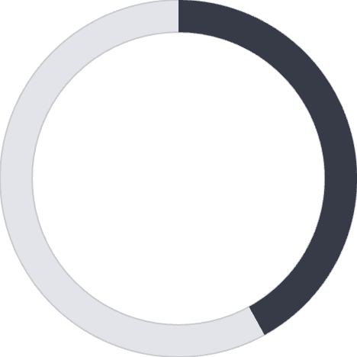

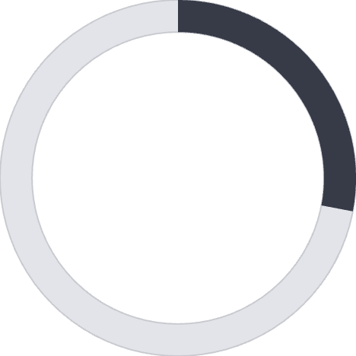
3. Gender Inclusion
From Section G (gender decision-making), plus gender-disaggregation in all outcome variables.
Decision-Making
KPMD Participation
Access to Resources
Income Control
65%
42%
28%
38%
Women deciding livestock sales,
attending trainings
Female-headed HHs engaged in KPMD
Women with access to
credit/savings
Women controlling share
of livestock income
Dashboard Visual Components
Side-by-side male vs female disaggregation across all metrics
Gender gap index panels (decision power, credit, income control) Heatmap of gendered participation by county

Slide 5



From sections on livestock productivity, coping, and environmental data.
Adaptation Practices
Percentage adopting drought coping strategies including feed storage and strategic destocking during dry periods.
GHG Proxy
4. Climate Impact
Average age at slaughter tracking (younger animals = lower methane emissions per unit of meat produced).
Resilience Through Coping
Percentage of households using adaptive vs erosive strategies during drought cycles and climate shocks.
Dashboard Visual Components
Time-series of coping strategies used across drought cycles
Comparative age-at-slaughter bar chart (baseline vs endline)
Climate resilience index tracking adaptation measures

Slide 6

Cross-Cutting Design
Data Integration
Pull directly from questionnaire sections (C–J) with automated data flows and real-time updates.
Integrated Dashboard Framework
Disaggregation
All metrics disaggregated by KPMD participation status and gender for comprehensive analysis.
Longitudinal Tracking
Show change over waves (baseline → midline → longitudinal) with trend analysis and impact attribution.
Decision Support
Tied to decision-use cases: climate impact guides feed/fodder investment, gender inclusion informs women-focused interventions.
Each dashboard theme provides actionable insights for program adaptation and scaling decisions, ensuring data-driven implementation of pastoral market transformation initiatives across target counties.

Slide 7
Appendix- Sample of the data presentation out-look

Slide 8
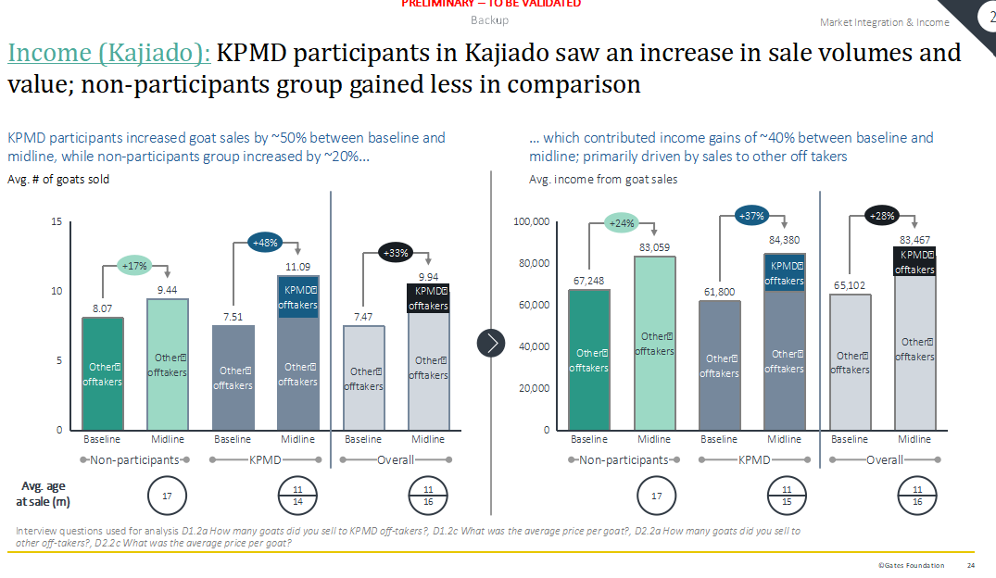
Sample output –for offtakes sales

Slide 9
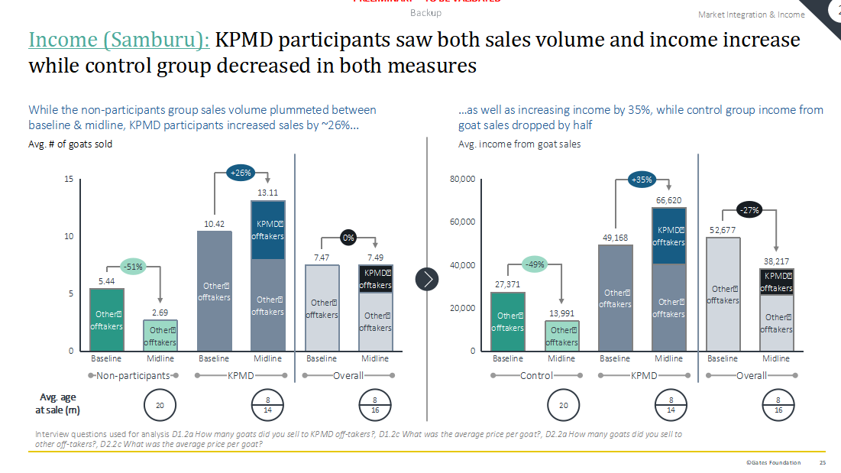
Sample slide output –for offtakes sales

Slide 10
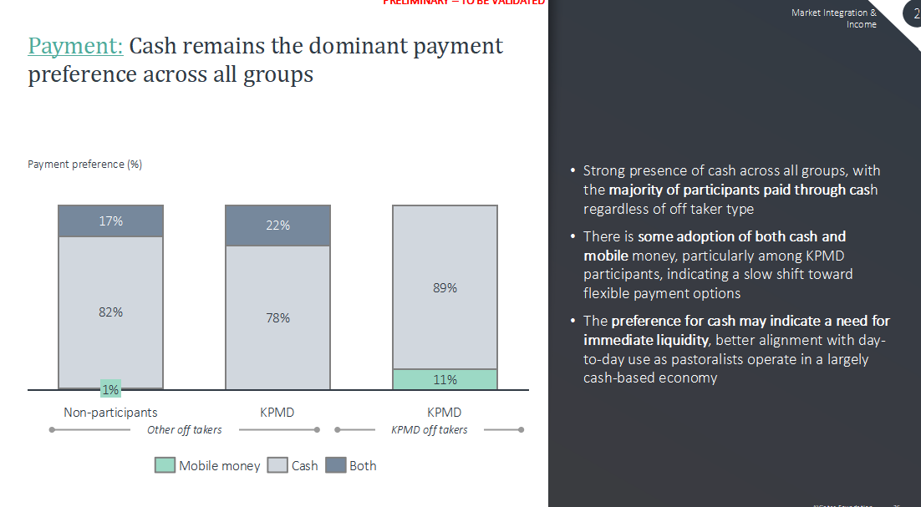
Sample

